Slide 1
Next.js Fundamentals
Bhawna Gunwani
Corporate Trainer and Consultant

Slide 2
Introduction to Next.js

Slide 3
What is Next.js?
Next.js is a popular open-source framework built on top of Node.js that enables React-based web applications to perform server-side rendering, static site generation, and more. It allows developers to build fast and scalable applications that can benefit from improved SEO, faster page loads, and a better overall user experience.

Slide 4
Key Features
Server-Side Rendering
Static Site Generation
Incremental Static Regeneration
API Routes
Image Optimization

Slide 5
Pre-requisites
JavaScript Fundamentals
Understanding HTTP and APIs
React Knowledge
Git and Version Control
Basic Command Line Usage

Slide 6
React before Next.js
Having knowledge of React before learning Next.js is essential because Next.js is built on top of React, and it assumes you already understand core React concepts.
Understanding Component-Based Architecture
Familiarity with React Hooks
State Management and Props
JSX Syntax and Rendering
Basic Understanding of Client-Side Rendering
Component Lifecycle Management

Slide 7
Next.js – The Hybrid Powerhouse 🚀
Client and Server in Harmony – Flexibility to render on both client and server.
SEO Made Easy – Server-Side Rendering & Static Site Generation boost visibility.
Blazing Performance – Fast loading with Automatic Code Splitting & Lazy Loading.
API Routes Built In – Simplified backend logic with Serverless Functions on demand.
One Framework, Any Page – Perfect for blogs, e-commerce, apps, or static sites.
File-Based Routing – No config required; each file is a route!
Effortless Data Fetching – Choose SSR, SSG, or client fetching for ultimate flexibility.
Perfect with TypeScript – Type safety and hybrid performance go hand-in-hand.

Slide 8
Next.js – The Future 🌐
Frontend & Backend in One – API routes make Next.js more than just a frontend.
Adaptable Rendering Options – SSR, SSG or CSR, tailor the experience to user needs.
Developer Happiness – Hot reloading, fast refresh, and dev-friendly CLI.
Production Ready from Day One – Pre-optimized for SEO, Performance, and Scalability.

Slide 9
Why Next.js? 🌟
Seamless Deployment
03
Deploy effortlessly on Vercel, AWS, and more.
Less Code, More Power
02
Achieve more with fewer dependencies.
Full-Stack Framework
01
Frontend and backend in one.

Slide 10
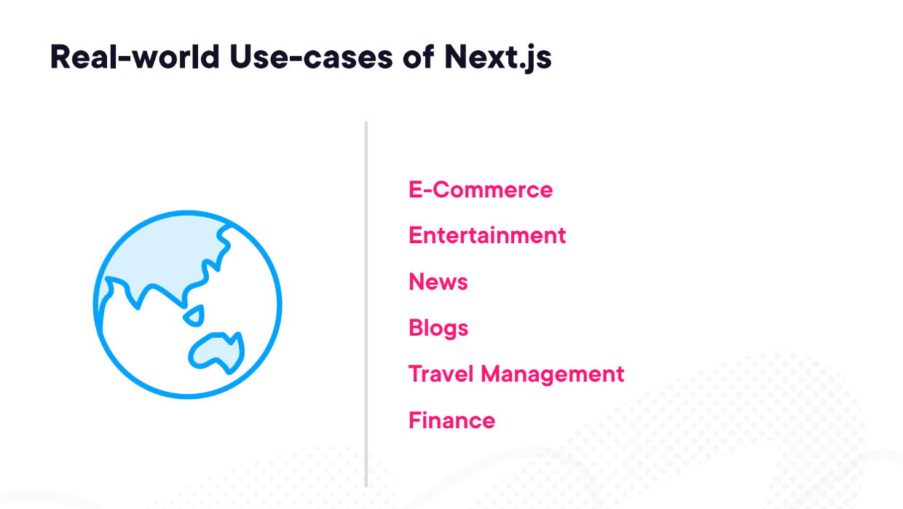

Slide 11

E-Commerce
Example: Zalando
Zalando, a major European online fashion retailer, uses Next.js to handle a high volume of dynamic product pages with fast load times.

Slide 12



Entertainment
Example: Hulu, Spotify for Artists, Epic Games
In the entertainment industry, Next.js is widely used to create fast, engaging, and interactive platforms.

Slide 13

News
Example: Washington Post
The Washington Post uses Next.js to deliver a vast amount of news content with a focus on speed and real-time updates.

Slide 14

Blogs
Example: Dev.to
Dev.to, a popular community for developers, uses Next.js to deliver content-focused pages with optimized performance and SEO.

Slide 15


Travel Management
Example: Booking.com, Expedia
Next.js is a powerful framework for building travel management platforms because of its performance, SEO capabilities, and flexibility with dynamic content.

Slide 16

Finance
Example: N26
N26, a digital bank, could use Next.js to build a fast and responsive app, providing customers with up-to-date financial information and transaction tracking.

Slide 17
Core Concepts

Slide 18
Core Concepts
Pages & Routing
Data Fetching
API Routes
Rendering Modes
Automatic Code Splitting

Slide 19




